Slide 1


Giving new teachers the support they need at the start of their careers
Why we should sign the
‘Promise to new teachers’

Slide 2

What’s the problem
Most new teachers start in short term positions
Sometimes the reasons for fixed term appointments are unclear or breach the STCA
Turn-over of new teachers is very high, 40% leave teaching within 5 years
The aging workforce and other pressures such as workload mean that there are increasing teachers shortages, we can’t afford to lose new teachers

Slide 3
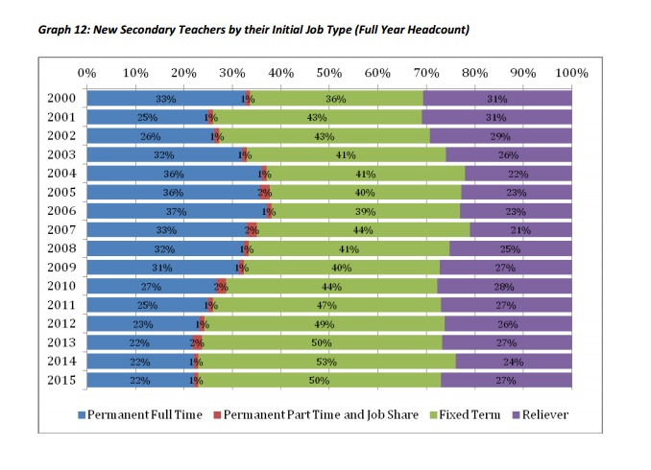
Fewer secure jobs for new teachers

Slide 4
The Promise to new teachers
The PPTA branch, school management and board commit to supporting new teachers
  Meeting legal requirements – i.e. legal reasons for fixed term appointments, giving other entitlements
  Looking after new teachers in terms of support, timetabling, classrooms.

Slide 5
What to do next
Branch to pass the resolution:
  That the …. school PPTA Branch supports the Promise to new teachers and asks the principal and board chair to sign it.
Let PPTA national office know how you get on, or if you need support, email us on nets@ppta.org.nz

